Slide 1
Port Property Management – Best Practices
Nicole Miranda, Property Manager III
PJ Christopher, Business Development Manager

Slide 2
We’re an economic engine for our region, creating opportunity for everyone who lives and works here.
Notes:
The Port of Portland operates three airports (including PDX!), four marine terminals, and five business parks. ​
Together, we are an economic engine for transforming our region into a place where everyone is welcome, empowered, and connected to the opportunity to find a good job or grow a business.​
Our job is to pull down barriers and connect people who have been left out of the region’s economic growth – including people of color, low-income workers, and people with disabilities – to powerful opportunities. ​
Using our resources, our expertise across industries, and our connections and influence, we:​
create thousands of jobs​
help local businesses of all sizes grow​
and help attract more quality employers to the state​

Slide 3
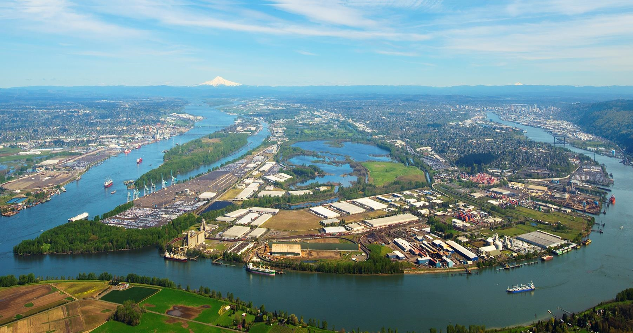
Troutdale Airport
Troutdale Reynolds Industrial Park
Gresham Vista Business Park
Portland International Airport
Terminal 2
Hillsboro Airport
Portland International Center
West Hayden Island
Swan Island
Terminal 6
Rivergate Industrial District
Terminal 4
Terminal 5
Notes:
This includes all POP property. However, this team manages only those properties not related to aviation assets.

Slide 4
Revenue Contract Making Process
Business Analysis Term Sheet (BATS)
Letter of Intent
Internal Approvals
Lease Negotiations
Commission Approval
Notes:
Business Analysis Term Sheet
Port subject matter expert review
Highlights areas of potential concerns, recommended lease rates and returns, economic impacts of the deal, shared prosperity elements to incorporate, etc.
Bare Land: Based on location, zoning, and future potential.
Warehouse: Consider location, size, and usage.
Office Space: Market rates, building amenities, and lease length.
Other Types: Adjust based on specific needs and market conditions.
Letter of Intent
Non – binding
Details the parameters of the deal i.e. term, rent, permitted uses, due diligence period, etc.
Negotiated with input from the BATS process in preparation for approval by Business Line management and Executive Leadership team.

Slide 5
Elements of a Typical Lease
Incentives
Rent and Term
Lease Escalations
Common Areas
Violations, Enforcement, Termination
Notes:
Incentives
Available Options to Close the Deal
Rent-Free Periods: Initial months without rent.
Improvement Allowances: Funding for tenant improvements
Build-Out Allowances: Financial contribution towards improvements.
Leasehold Improvements: Who owns improvements at lease end.
Approval Process: Tenant and landlord agreement on changes.
Escalations
Moving away from Consumer Price Index (CPI) adjustments to yearly fixed rate increases for cash flow budgeting purposes
Fair Market Value (FMV) adjustments typically every 5 years
Common Areas
Common Area Maintenance (CAM):
Historic focus on landscaping maintenance. Port reviewing to included shared common access driveways, roads, shared yard/parking lighting, etc. in the CAM allocations (square feet of lease area by total industrial area)
Usage Restrictions: Ensure clear guidelines on common area use.
Violations Enforcement Termination
Standard Clause: 60-day written notice from either party with not typical deviate from that
Enforcement: Procedures for addressing rule breaches.
-lots of emails and certified letters
Eviction Process: Legal steps and collection processes.

Slide 6
Property Maintenance & Inspections
-Tenant vs. Property Owner
-Maintenance matrix
-Annual inspections
Notes:
Tenant typically interior maintenance, janitorial.
Property Owner: external structural repairs, major systems maintenance up to building, common area asphalt and perimeter fencing
Maintenance matrix as lease exhibit for ease of use
Yearly joint inspections with owner and tenant, documenting property condition and tenant compliance.

Slide 7
Property Management Best Practices
-Key Strategies
-Regular Maintenance
-Tenant Relations
-Financial Management
Notes:
Your attorney is your best friend
Templates are your second best friend
Templates for every type of real estate document speeds up negotiations by ensuring all parties are focused on their important needs
Key Strategies
Templates, templates, templates
Regular Maintenance: Scheduled and preventative maintenance.
Tenant Relations: Clear communication and responsive service.
Financial Management: Budgeting and expense tracking.

Slide 8
Easement vs. Selling vs. Leasing Considerations
-Temporary or permanent use
-Value
-Property Impact and Future Needs
Notes:
Easement: Rights granted without property transfer (utility corridors, access easements). Easement consideration. Sometimes easements can be more restrictive, have more rights/responsibilities than a lease. Is the easement temporary, or in perpetuity? Is it exclusive easement or non-exclusive easements rights? What can the property owner still do with the area in the easement (pave over, parking lot, access?)
Negotiation Tips: Consider value, impact, and future property owner needs.
Easements will usually take longer to negotiate than you think – this is where an easement template will be of great use.
Selling: Transfer of ownership. Port prefers leasing or easements for cash flow
Leasing: Temporary use with conditions.

Slide 9
Thank you
Notes:
Closing slide – Thank you

